Slide 1
Tread lightly
Be the change you want to see in the world. - Ghandi
by Gordana Popović

Slide 2
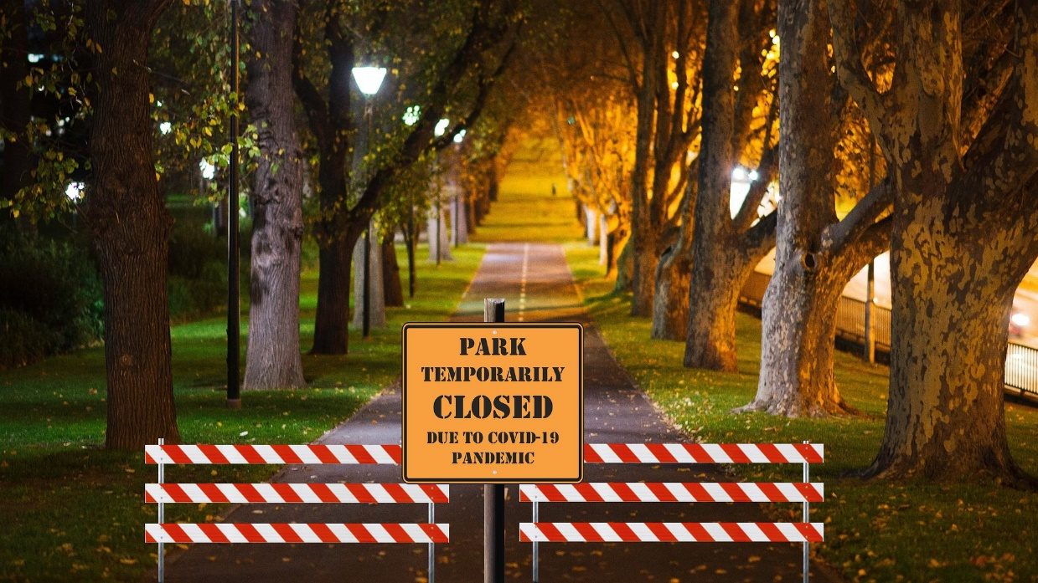
Finding good in evil
Covid-19 has had a significant impact on our lives.
It has made us change our habits, the way we behave, learn, work and spend our free time.
It has left schools, factories, offices, and streets empty.

Slide 3
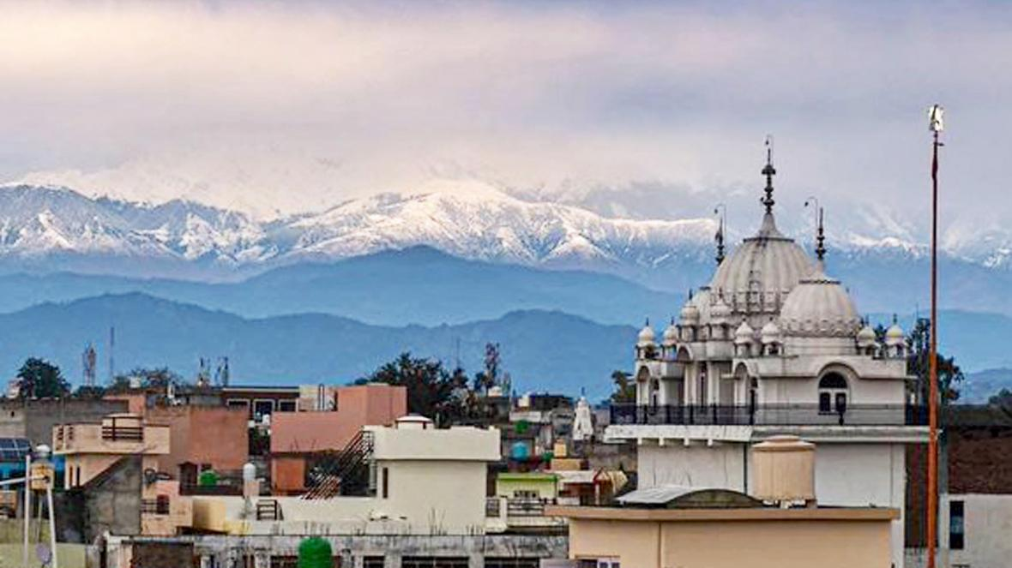
Finding good in evil
In the meantime, air quality has improved.
Social media have been swamped by photos and videos of nature healing.
https://padlet.com/teachergordanap67/nature
The Himalayas stand clear to view from Pathankot, in the Punjab. The coronavirus lockdown has rapidly reduced pollution
@PARASRISHI

Slide 4
The word of scientists
Are the photos and videos that have flooded social media genuine or fake?
We need some proof.
In groups, we have searched for the scientific explanation of the phenomenon.
https://docs.google.com/presentation/d/1aU6ncslRscIL5hLsnG-4GuktgUiacvOJAhBORTUUnbY/edit?usp=sharing

Slide 5
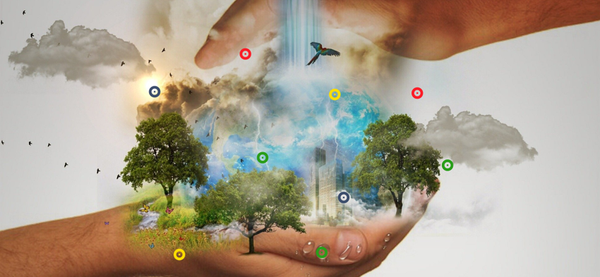
All the links in one place
https://www.thinglink.com/scene/1312007732684914691

Slide 6
Lessons learnt
Then we have reread the articles, analyzed the contents and drawn some conclusions.
Actions to be taken
Predictions
Governments should focus on creating new environmental laws and policies to encourage a sustainable environment by reducing the pollution and switching to renewable energy.
Covid-19 may result in a temporary reduction in greenhouse gas emissions, but it is not a substitute for sustained climate action. With no political pressure on governments, the world will go back to unsustainable business as usual.
.
Causes
Status
With non-essential industries being shut down and dramatic reduction in road and air traffic, carbon emissions have been falling around the globe.
The first signs of improvement were observed through satellite imagery from space. Then we could feel them in the air and our lungs, and images of clean air, clear channels and rivers toured the world.

Slide 7
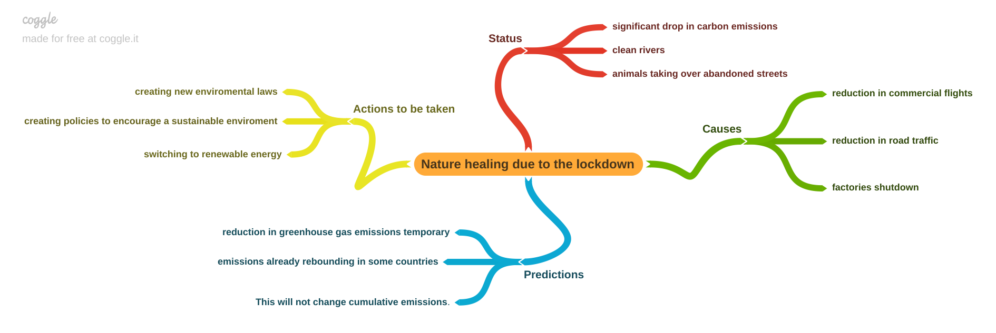
Our mindmap
We have also presented them in this mindmap.

Slide 8
Оur turn
So, nature heals when we do nothing.
How about doing something, but differently?
Let’s think of some ways to make our carbon footprint lighter.
https://docs.google.com/document/d/1vi2LoE2p4WcCOr-5lNMoWU7u82JfLtbD8saAEcMGPeE/edit?usp=sharing

Slide 9
Treading lightly
My new good habits
When taking a shower or brushing my teeth, I will turn off the faucet and thus reduce water consumption.
I will buy items that are packed in plastic less, and I will use special bags for garbage.
Addressing student parliament
At home
At school
In schools we can separate waste (paper, glass, plastic) and recycle it.
We could organize a contest in creative reuse of PET bottles.
Suggesting actions
In the neighbourhood
In our hometown
We can plant some trees in our street together.
We can collect organic waste and make compost for our gardens.
Contacting local officials
I would suggest posting machines, from which, when we dispose of waste, we get a certain amount of money.
Suggest setting up more bins for waste disposal.

Slide 10
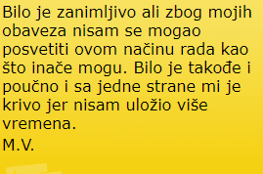
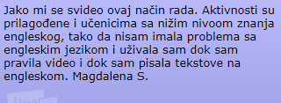
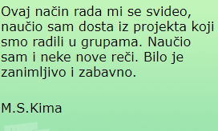
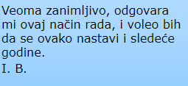
Evaluation
Thank you

